Slide 1


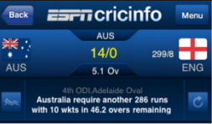

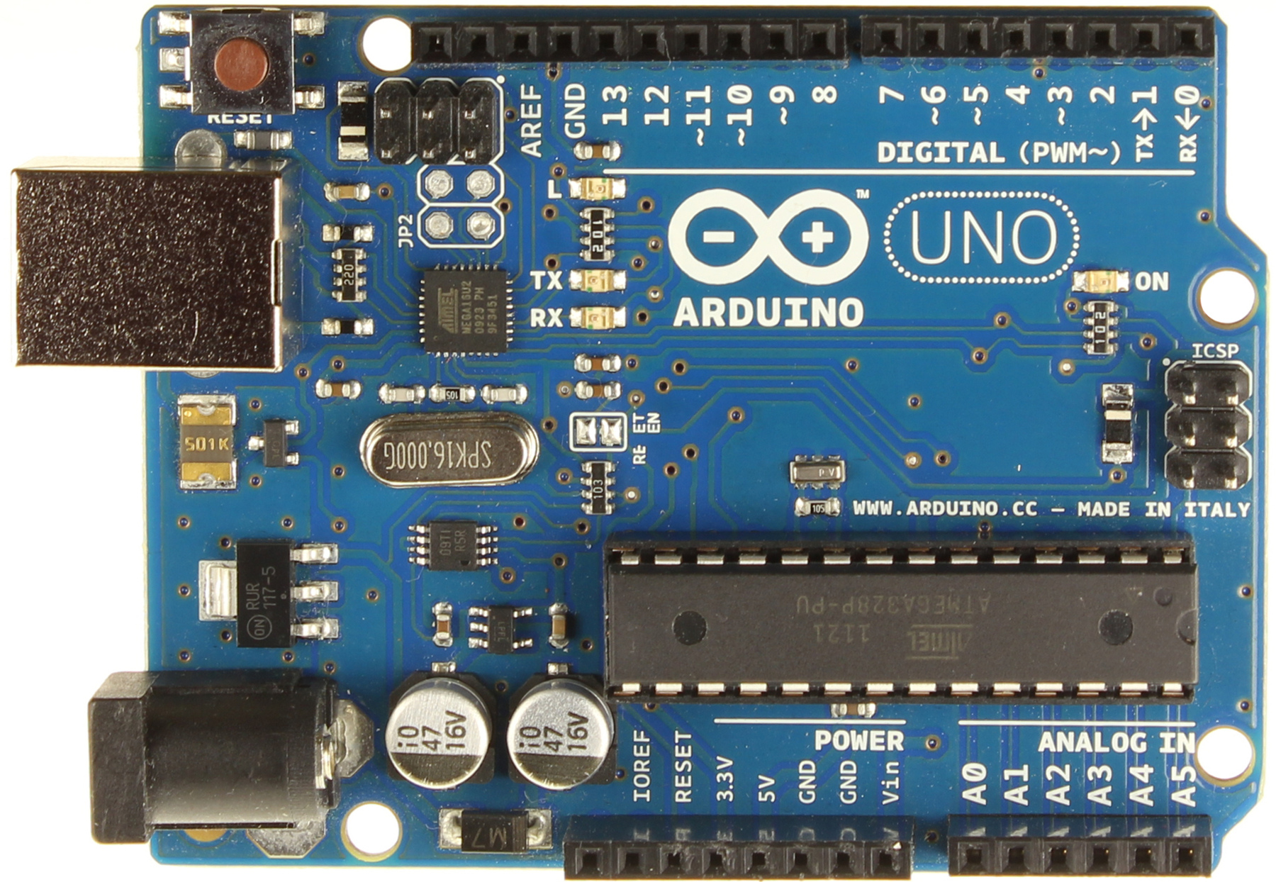
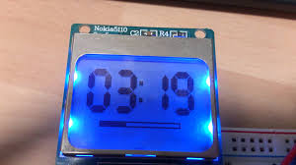
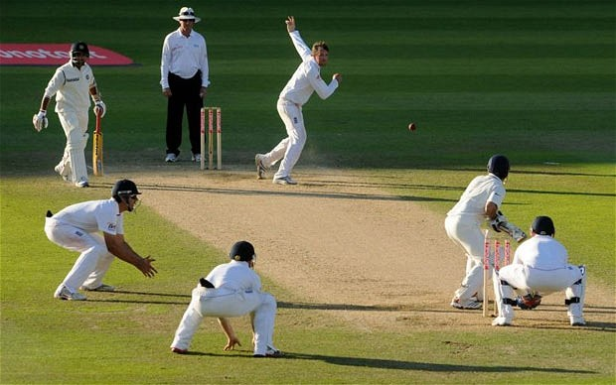
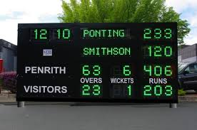
hhhhhhhhhhhhh
Cricket
Scoreboard
Cricket Scoreboard
Database
Server
Input Score
Mobile App
Bluetooth
Bluetooth
Data base Server
Scoreboard Input Mobile App
Adruino via Bluetooth
User App
Arduino
Arduino
User App
LCD
Display
Scores
LCD Scoreboard
Cricket Match

